Slide 1

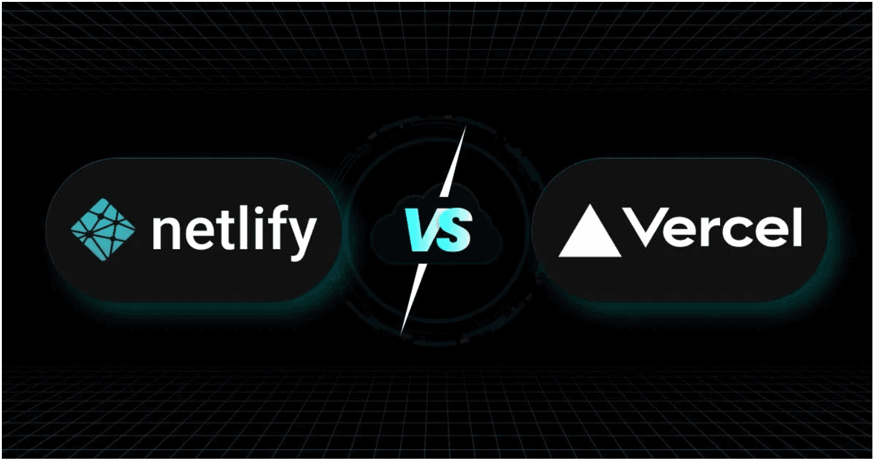
Netlify vs. Vercel: Key Differences
Feature
Netlify
Vercel
Primary Focus
All-in-one JAMstack
Next.js & React
Serverless Functions
Netlify Functions
Edge & Serverless
Global Edge Network
Netlify Edge
Vercel Edge Network
Pricing Model
Feature-based plans
Usage-based plans
Ecosystem
Open standards focus
Next.js ecosystem
Build System
Build Plugins
Next.js optimized
Netlify is ideal for projects requiring broad JAMstack support and an all-in-one platform for hosting, serverless, and CDN. Vercel is the optimal choice for Next.js and React applications, offering deep framework integration and superior performance optimization.

